Slide 1


Performance Attribution
Georgio Najm
and
Tevin Parathattal
October 20, 2025

Slide 2
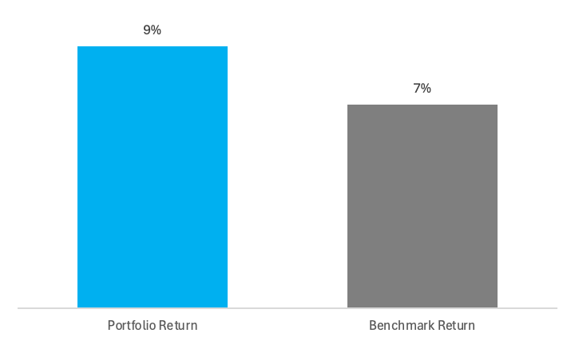
Why Performance Attribution Matters?
After measuring performance, attribution tells us why those results really happened
Why it matters:
- Shows whether outperformance came from strategy or market exposure
- Separates skill from luck
- Reveals which decisions added or hurt performance
Goal for SMIF: Connect results to measurable sources of return
Notes:
Once we calculate portfolio performance, we still need to understand what drove our results.
Attribution separates skill from market risk — showing if returns came from active decisions or market movement.
It identifies which decisions added value and which didn’t add value.
And it helps us improve — by linking performance to strategy.

Slide 3
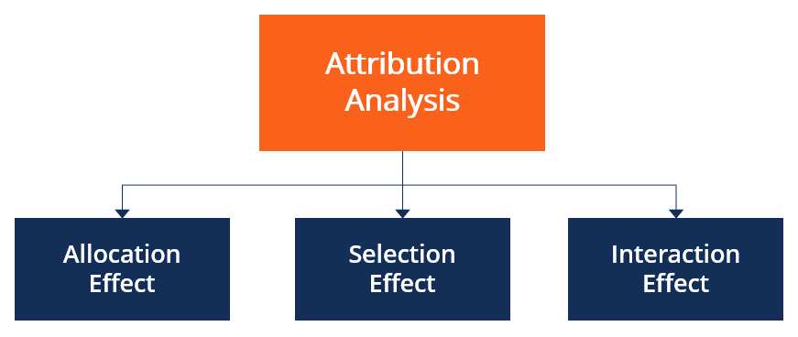
What is Performance Attribution?
Performance attribution explains why a portfolio’s return differs from its benchmark by breaking excess return into three effects:
Allocation Effect – Measures the performance impact resulting from overweighting or underweighting specific sectors and or asset classes relative to the benchmark.
Selection Effect – Quantifies the value added or subtracted by selecting specific securities within each sector and or asset class compared to the benchmark.
Interaction Effect – Combined influence of both allocation and selection effect.
Notes:
Attribution breaks down total excess return — that’s the difference between the portfolio and the benchmark.
It shows where our returns came from by looking at three effects:
Allocation effect: How our sector weights differ from the benchmark.
Selection effect: How our stock picks performed within each sector.
Interaction: The combined influence of both weighting and selection.
Together, these three explain every basis point of excess return .

Slide 4
The Brinson-Fachler Model (1985)
A_{i} = (w_{i} - W_{i})(b_{i} - R_{B})
Allocation Effect = [Portfolio weight – Benchmark weight] × [(Benchmark return – Total benchmark return)]
S_{i} = w_{i}(r_{i} - b_{i})
Selection Effect = [Portfolio weight] × [Portfolio return – Benchmark return]
I_{i} = (w_{i} - W_{i})(r_{i} - b_{i})
Interaction Effect= [Portfolio weight – Benchmark weight] × [Portfolio return – Benchmark return]
The Brinson–Fachler (BF) model refines the original attribution framework.
It measures allocation, selection, and interaction effects, but adjusts the allocation effect to compare each sector’s return to the total benchmark return (R_{B}).
This makes it a relative attribution model – evaluating whether managers overweighted sectors that outperformed the benchmark overall.
The allocation effect rewards overweighting outperforming sectors and penalizes overweighting underperforming ones.
The selection and interaction effects are identical to the BHB model.
Because the BF model evaluates returns on a relative basis, it provides a more accurate measure of the manager’s active decisions.
wᵢ = portfolio weight
Wᵢ = benchmark weight
rᵢ = portfolio return
bᵢ = benchmark return
R_{B} = total benchmark
Notes:
Brinson–Fachler (1985) Model
Developed by Gary Brinson and Nimrod Fachler in 1985
This model is the analytical foundation for modern performance attribution.
It breaks the portfolio’s excess return into allocation, selection, and interaction — but with one key difference.
The allocation term compares each sector’s return to the total benchmark return (Rᴮ) — not just its own sector benchmark.
That makes it a relative model — it rewards overweighting sectors that outperformed the overall market, and penalizes those that lagged.
This is the most accurate version of the Brinson Model because it looks at how each sector performed compared to the whole market, not just within itself.

Slide 5
The Brinson-Hood-Beebower Model (1986)
A_{i} = (w_{i} - W_{i})b_{i}
Allocation Effect= [Portfolio weight − Benchmark weight] × [Benchmark return]
S_{i} = w_{i}(r_{i} - b_{i})
Selection Effect = [Portfolio weight] × [Portfolio return – Benchmark return]
I_{i} = (w_{i} - W_{i})(r_{i} - b_{i})
Interaction Effect= [Portfolio weight – Benchmark weight] × [Portfolio return – Benchmark return]
The Brinson–Hood–Beebower (BHB) model simplifies the Fachler version.
Uses each sector’s own benchmark return (bᵢ) rather than the total benchmark return (R_{B}).
This makes the model easier to compute and explain, especially for client communication.
The allocation effect now measures whether the manager overweighted sectors that had strong absolute returns, not just those that outperformed the market.
The selection and interaction effects are defined the same way as in the BF model.
Although slightly less precise, the BHB model became the industry standard for reporting performance attribution due to its simplicity and clarity.
wᵢ = portfolio weight
Wᵢ = benchmark weight
rᵢ = portfolio return
bᵢ = benchmark return
R_{B} = total benchmark
Notes:
The Brinson–Hood–Beebower model, or BHB, was introduced one year after the Fachler model.
It uses the same framework — allocation, selection, and interaction
In this version, the allocation effect uses each sector’s own benchmark return (bᵢ) instead of comparing it to the total benchmark return (Rᴮ).
That makes it an absolute model — it looks at how each sector performed on its own, not compared to the overall market.
Did we overweight sectors that performed well?’
The selection and interaction effects stay the same as in Fachler.
This version is easier to explain and interpret, which made it more popular for presentations and client reporting.
Even though it’s not as exact as the Fachler version, both models tell the same story — where our portfolio’s returns came from.

Slide 6
Step 1: Separate Equities into Sectors
Sector | Holdings | Benchmark ETF
Communication Services | META, T | XLC
Consumer Discretionary | NKE, VCR | XLY
Consumer Staples | WMT | VDC
Core Bonds | AGG | AGG
Energy | LNG | XLE
Financials | V | XLF
Health Care | UNH, ABBV, ABT, JNJ, CVS | XLV
Industrials | MMM, HII | XLI
Information Technology | AAPL, MSFT, QCOM | VGT
International Developed | VEA | VEA
Materials | SOLV | XLB
Real Estate | PSA | XLRE
US Large Cap | VOO | VOO

Slide 7
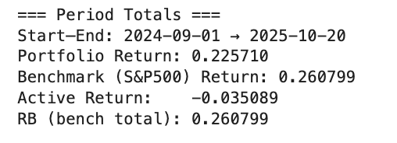
Performance Summary
The portfolio underperformed the S&P 500 by 8.1% over the period.
Attribution analysis identifies Technology underweighting and weak stock selection as primary reasons.

Slide 8
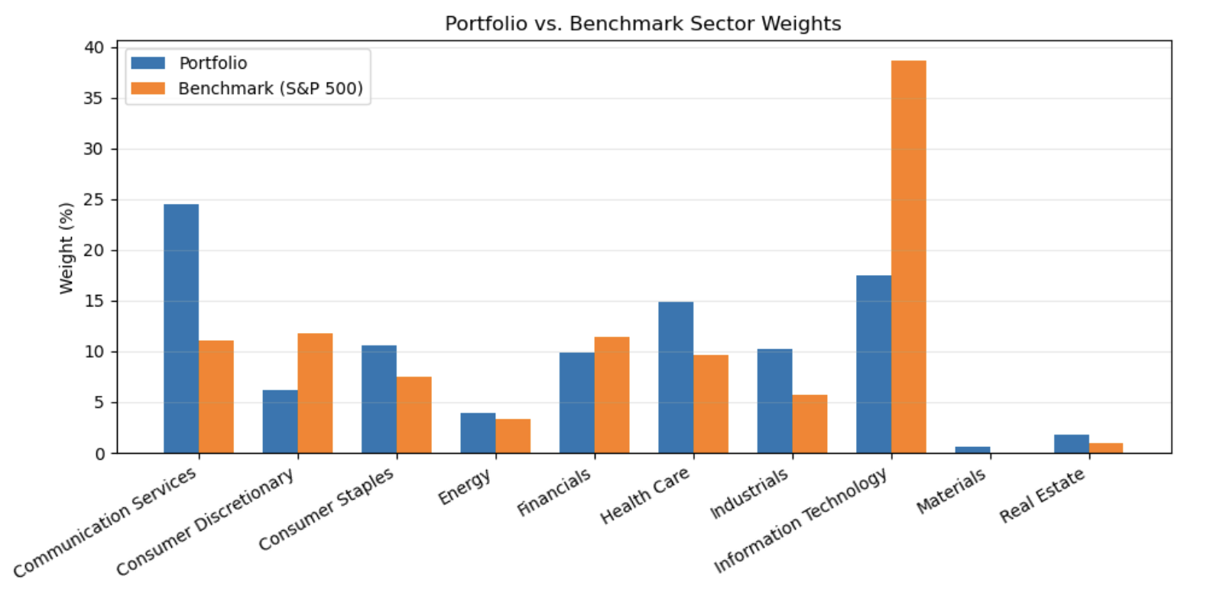
Benchmark & Portfolio Composition
The S&P 500 is heavily concentrated in Information Technology (~28%) and Health Care (~13%).
The portfolio was underweight Technology (15%) and overweight Consumer Staples (12%), influencing performance sensitivity.

Slide 9
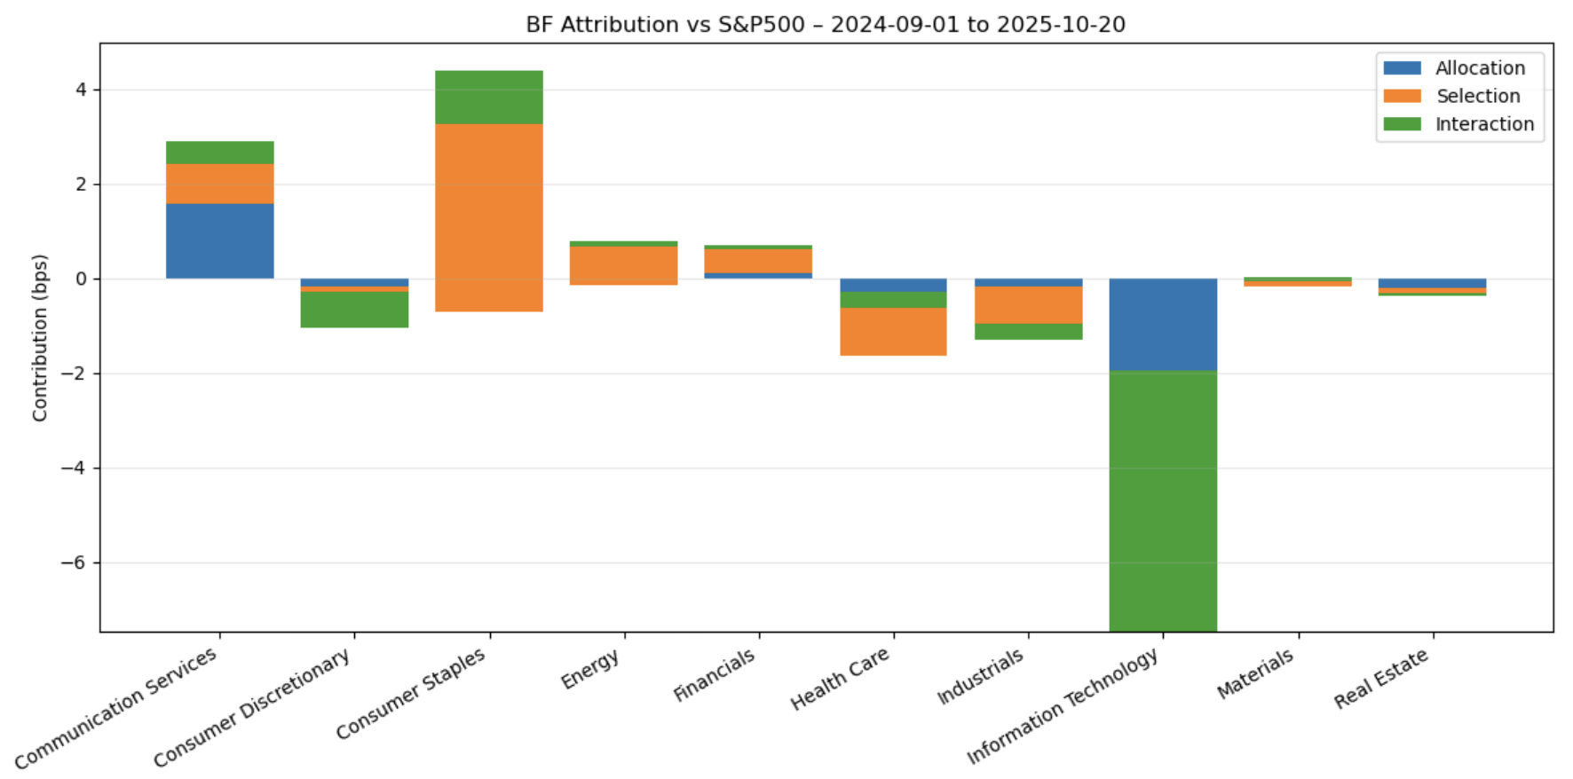
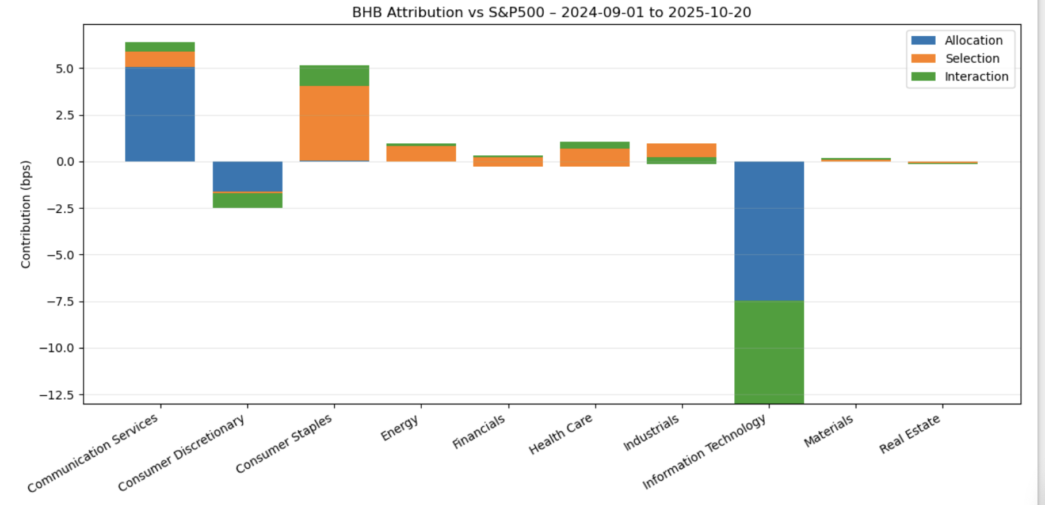
Attribution Chart
Sector | Contribution | Key Driver
Information Technology | -6.1 bps | Underweight and underperformance vs VGT
Consumer Staples | +4.4 bps | Overweight during strong performance
Communication Services | +2.9 bps | META outperformance vs XLC
Industrials | -1.3 bps | Stock-specific lag in HII, MMM
Health Care | -0.8 bps | Flat vs XLV
Energy | +0.7 bps | Overweight LNG added value

Slide 10
Table
Sector | Portfolio Weight (%) | Benchmark Weight (%) | Portfolio Return (%) | Benchmark Return (%) | Allocation (bps) | Selection (bps) | Interaction (bps) | Total (bps)
Consumer Staples | 10.53 | 7.55 | 39.78 | 2.1 | -71.48 | 396.85 | 112.33 | 437.71
Communication Services | 24.52 | 11.08 | 41.17 | 37.69 | 156.05 | 85.28 | 46.73 | 288.05
Energy | 3.95 | 3.31 | 22.12 | 1.5 | -15.63 | 81.38 | 13.11 | 78.87
Financials | 9.88 | 11.36 | 24.5 | 18.59 | 11.13 | 58.38 | -8.78 | 60.73
Materials | 0.61 | 0 | 14.21 | -1.25 | -16.77 | 9.48 | 9.48 | 2.2
Consumer Discretionary | 6.22 | 11.71 | 15.4 | 29.45 | -18.52 | -87.36 | 77.23 | -28.65
Health Care | 14.81 | 9.63 | 0.99 | -5.84 | -165.2 | 101.12 | 35.35 | -28.73
Real Estate | 1.8 | 0.93 | -4.49 | 1.2 | -21.65 | -10.25 | -4.95 | -36.84
Industrials | 10.2 | 5.74 | 14.26 | 21.81 | -19.09 | -76.97 | -33.71 | -129.78
Information Technology | 17.48 | 38.68 | 13.88 | 39.9 | -292.86 | -454.8 | 551.4 | -196.27

Slide 11
Conclusions and Takeaways
Underweight in Tech hurt most – S&P Tech drove market returns, and we were 20+% underweight.
Strong sector calls in Consumer Staples and Communication Services offset part of the drag.
Stock selection inconsistency – great in some sectors, poor in others (especially Health Care).
Portfolio not benchmark-aligned – large deviations from S&P sector weights amplified performance differences.
Possible Next Steps
Adjust Tech exposure – bring it closer to benchmark weight to avoid missing index-driven upside.
Tighten stock selection process in Health Care and Discretionary sectors.
Maintain winners in Consumer Staples and Communication Services.
Move toward “benchmark-aware” weighting to balance tactical tilts with diversification.
Continue attribution tracking quarterly to identify alpha consistency over time.

Slide 12
QUESTIONS?

